Slide 1
Book Buddy Sprint 4 Update
Team 5 - Code Avengers
Pace University Capstone Project - Spring 2024

Slide 2
Agenda
Team Details
Improvements Made
Project Description
Working Agreement
Personas
Technologies
Algorithms
Diagrams
Product Backlog
Sprint Summaries
Sprint 4 Backlog
Metrics
Retrospective
Demo

Slide 3



Team Members
Jimmy Karoly
Scrum Master/Developer
Dhanasri Salla
Machine Learning Engineer
Sai Sandeep Mandava
Machine Learning Engineer

Slide 4



Team Members
Praveen Raj Gujju
Tester
Anusha Meka
Developer
Sairam Vinjamoori
Developer

Slide 5

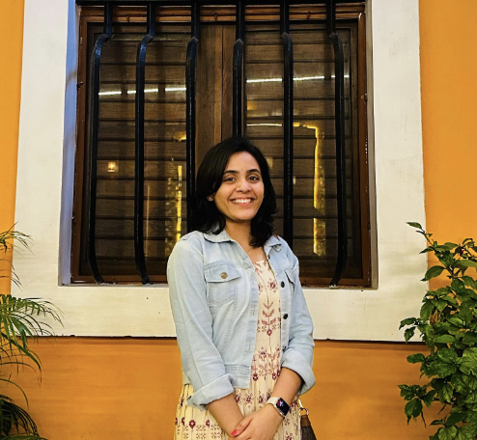
Team Members
Krushal Rama
Developer
Alekhya Bommineni
Developer

Slide 6
Changes due to Professor’s Feedback
Used stories for Sprint recap instead of bullet points
Added historic and average metrics
Reformatted chart slides to show headers if charts were split
Made MVP description more detailed
Corrected labels for burndown charts
Slides with changes have this icon:

Slide 7
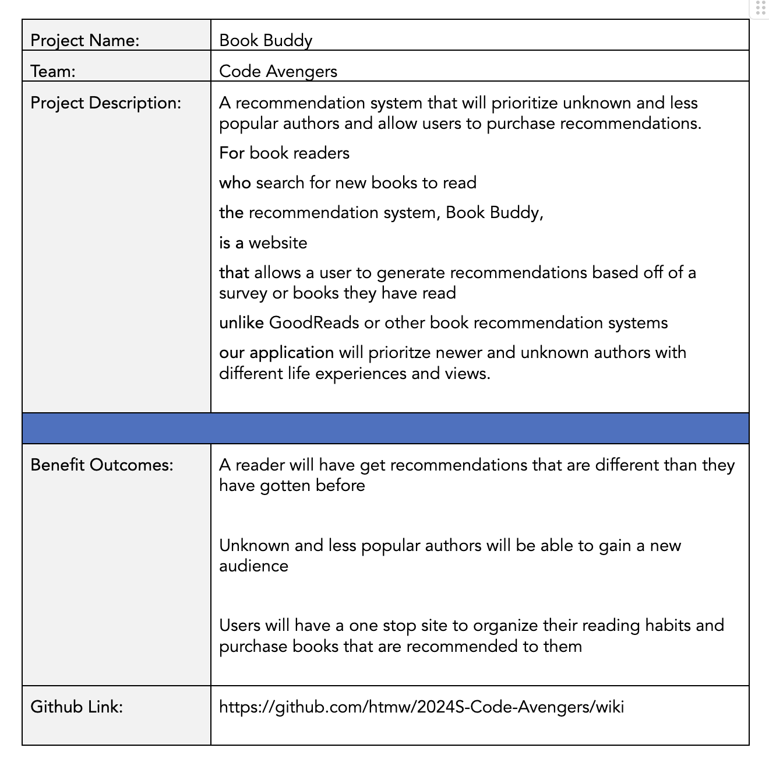
Project Description

Slide 8
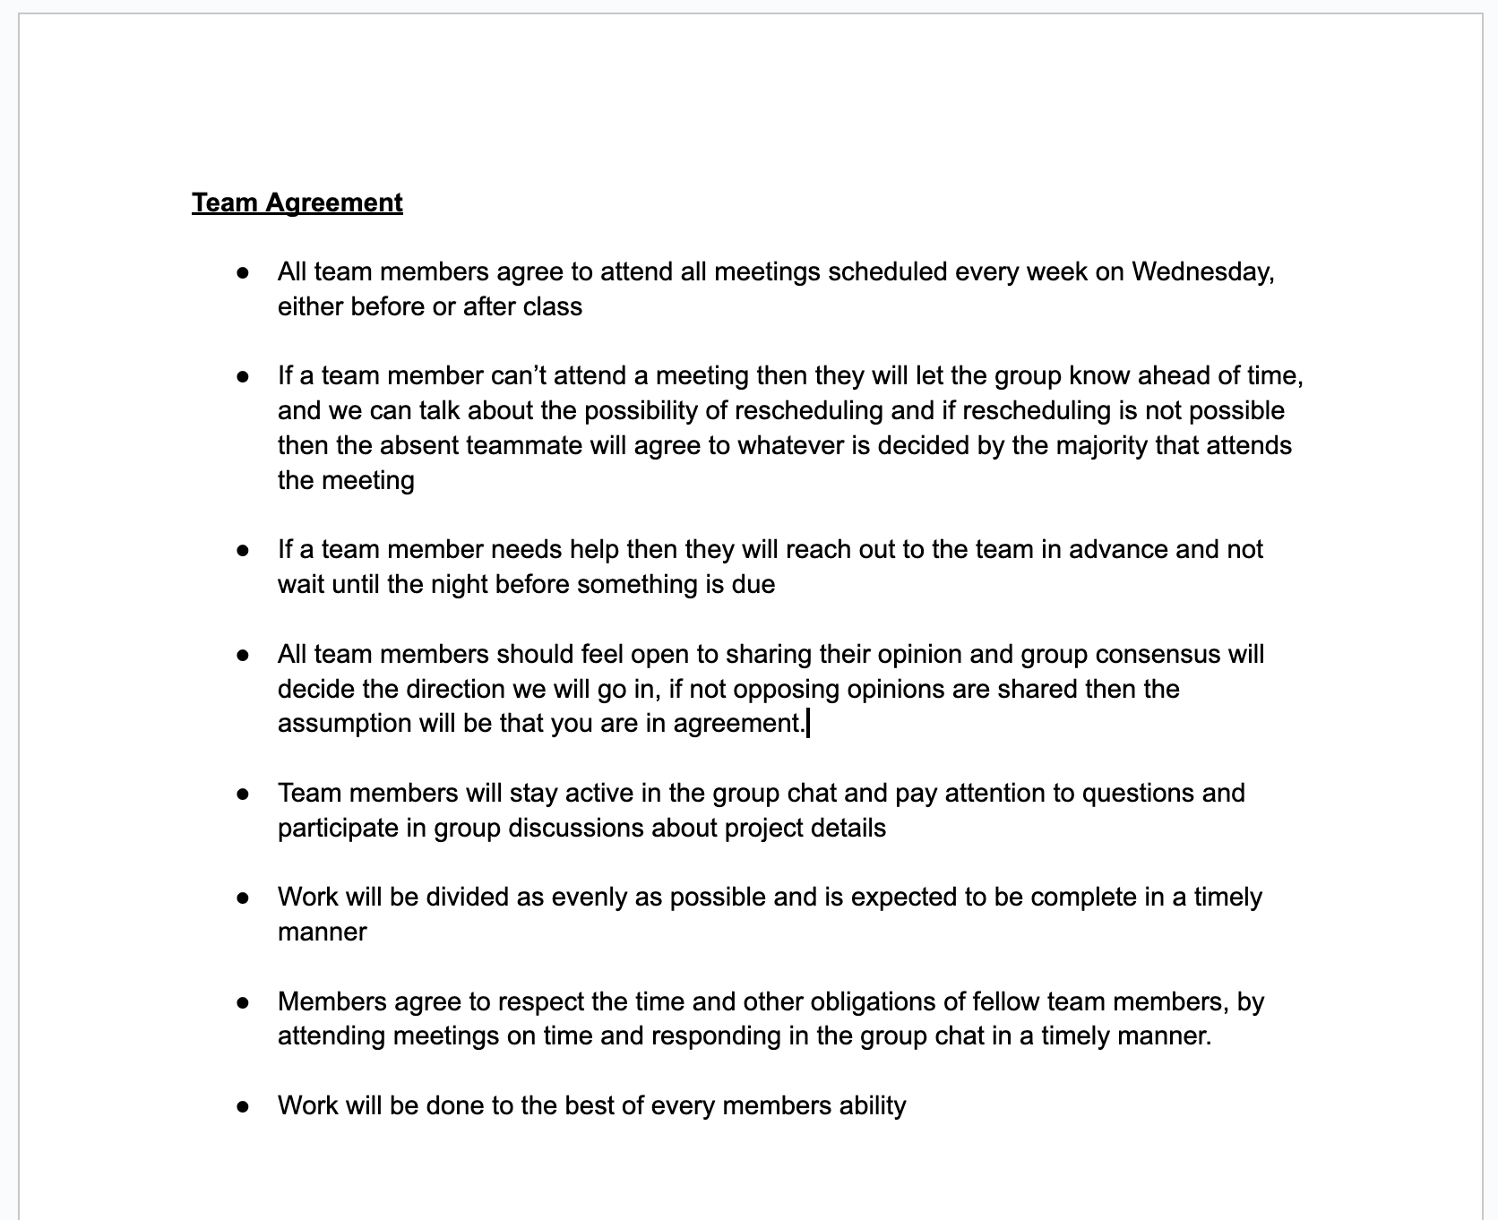
Team Working Agreement

Slide 9
Personas

Slide 10
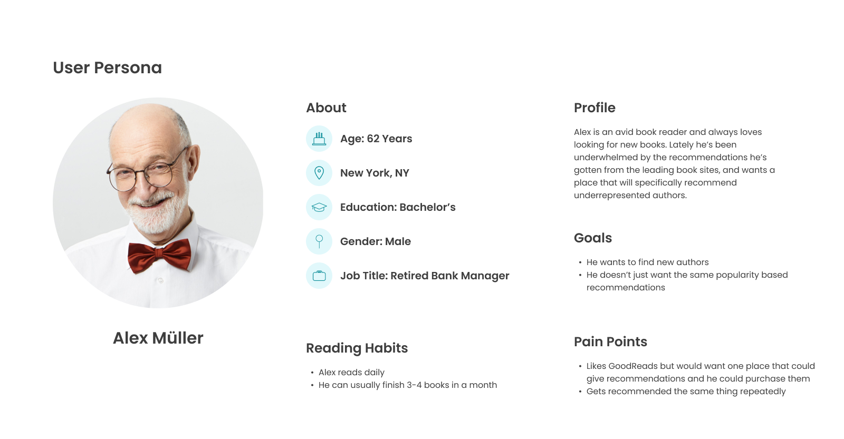

Slide 11
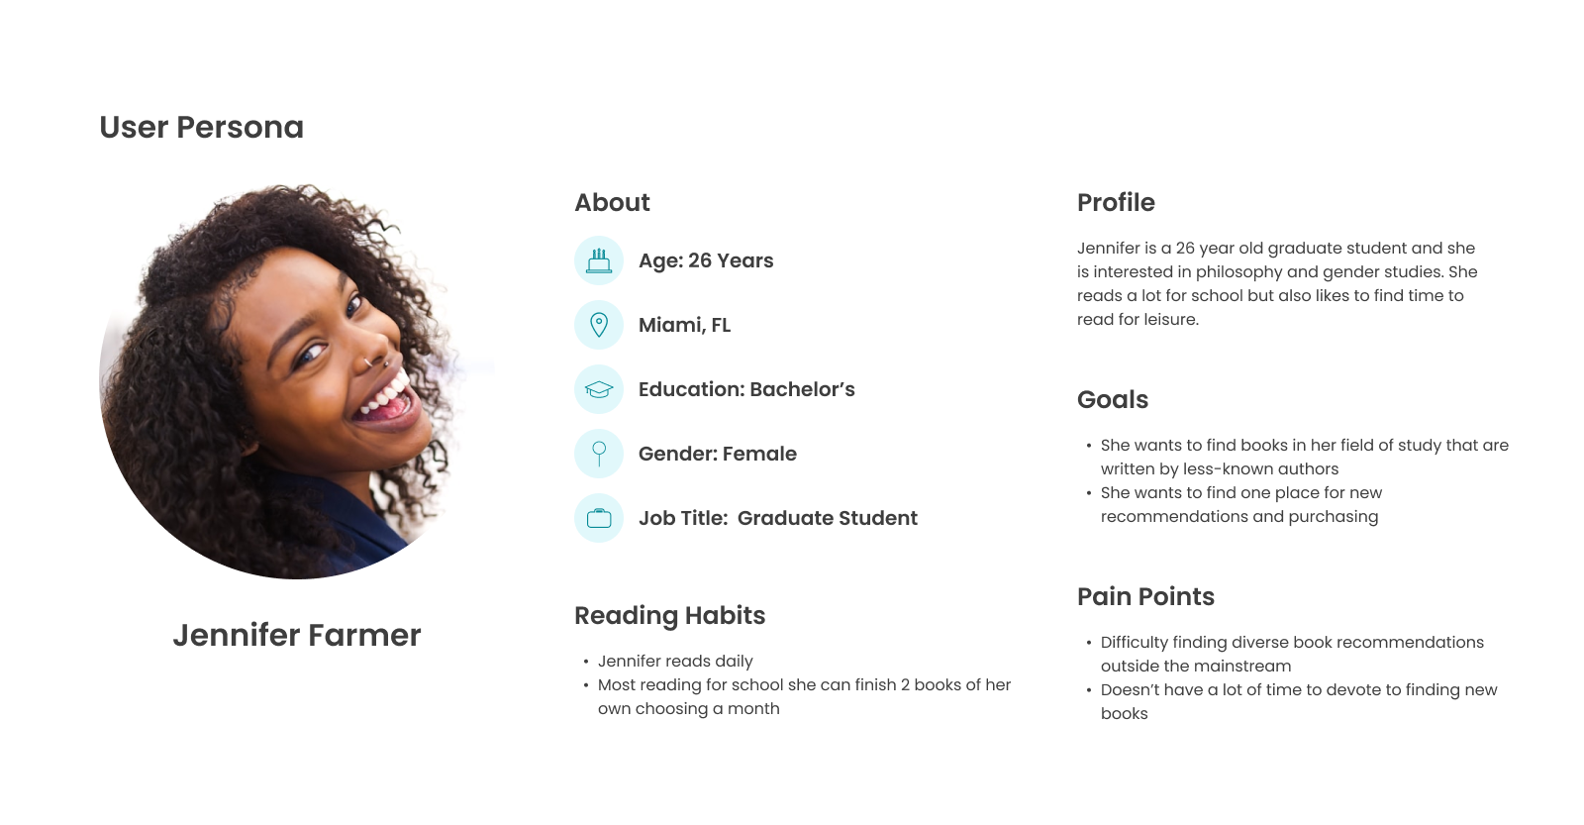

Slide 12
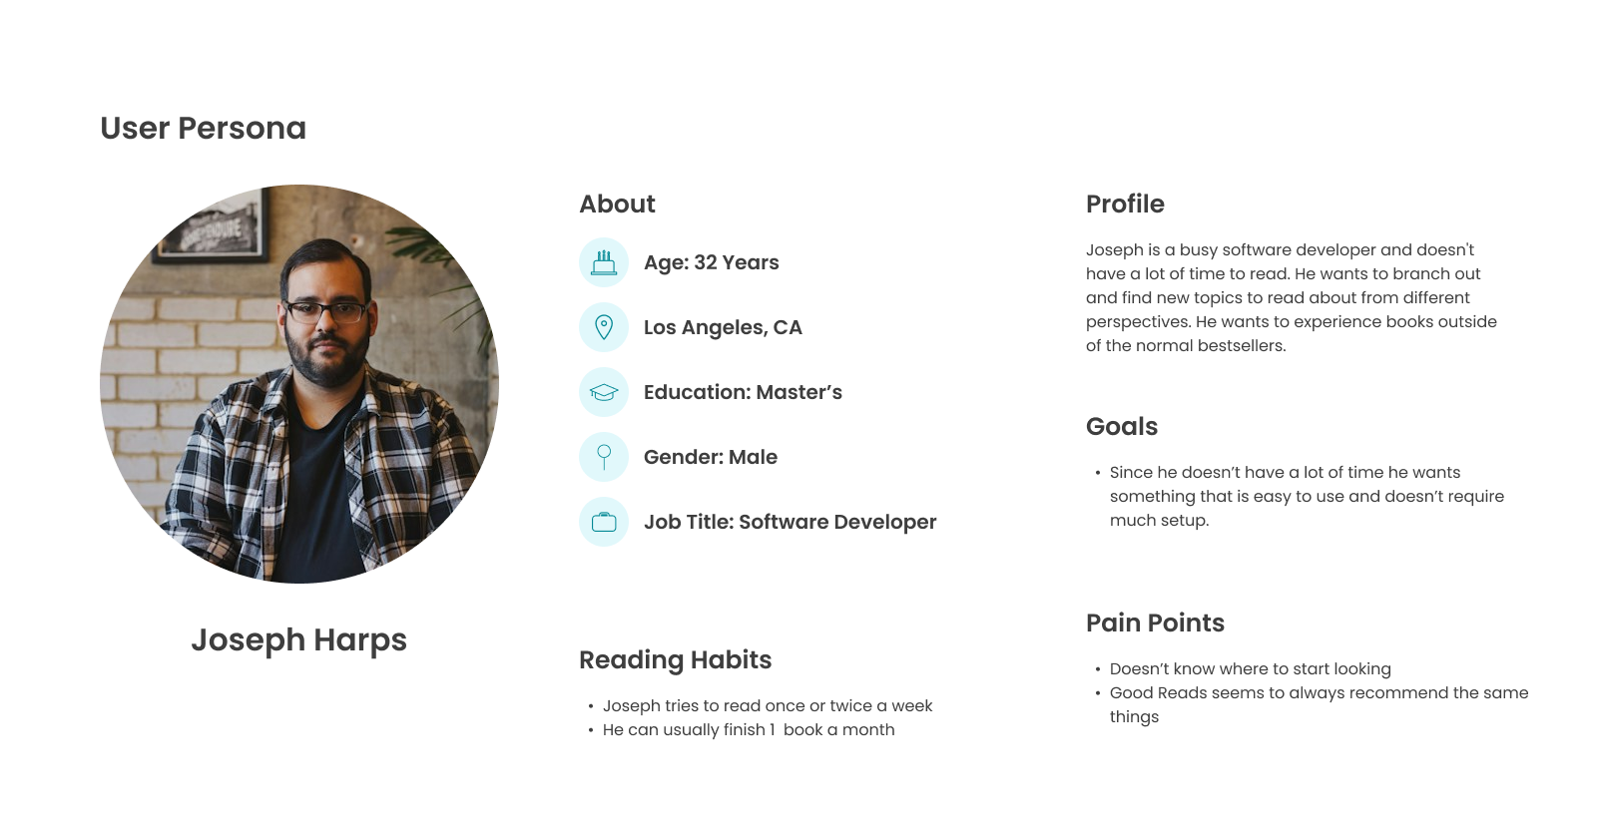

Slide 13
Minimum Viable Product
Our MVP will consist of the following functionalities:
Generate Book Recommendations for the User
The User can create and manage custom book collections such as: “Books to Read” or “Books I Love”
The site will contain basic marketplace functionality with a shopping cart the user can manage and being able to purchase books.

Slide 14
Technologies and Algorithm

Slide 15




Front End Technologies
We will be using the React JS library to create our UI along with some HTML and CSS as well.
For our login/registration we will be using Google Firebase. They allow you to interact with it through an API

Slide 16




Back End Technologies
We are using PyTorch for our ML Algorithm
We will create an API for the algorithm using Python
The backend will be written in Java using the Spring Framework
Our Database will be Postgres

Slide 17
Machine Learning Algorithm
Feature Vector Construction:
Represent each book as a vector of features. Each dimension corresponds to a specific characteristic or keyword associated with the book. For textual features, use techniques like TF-IDF to weight the importance of each word or tag.
2. Cosine Similarity Calculation:
Calculate the cosine of the angle between two book vectors, A and B, using the formula: Cosine Similarity = (A⋅B)/‖A‖‖B‖
Where:
A⋅B is the dot product of vectors A and B ‖A‖ and ∥B∥ are the magnitudes (Euclidean norms) of vectors A and B, respectively.
3. Interpretation:
The cosine similarity ranges from -1 to 1, where 1 means identical, 0 indicates orthogonality (no similarity), and -1 implies opposite. For book recommendations, we focus on positive similarity scores, with higher scores indicating greater similarity.
4. Recommendation:
For a target book, calculate its cosine similarity with all other books in the dataset. Recommend books with the highest similarity scores to the reader.

Slide 18
Diagrams

Slide 19
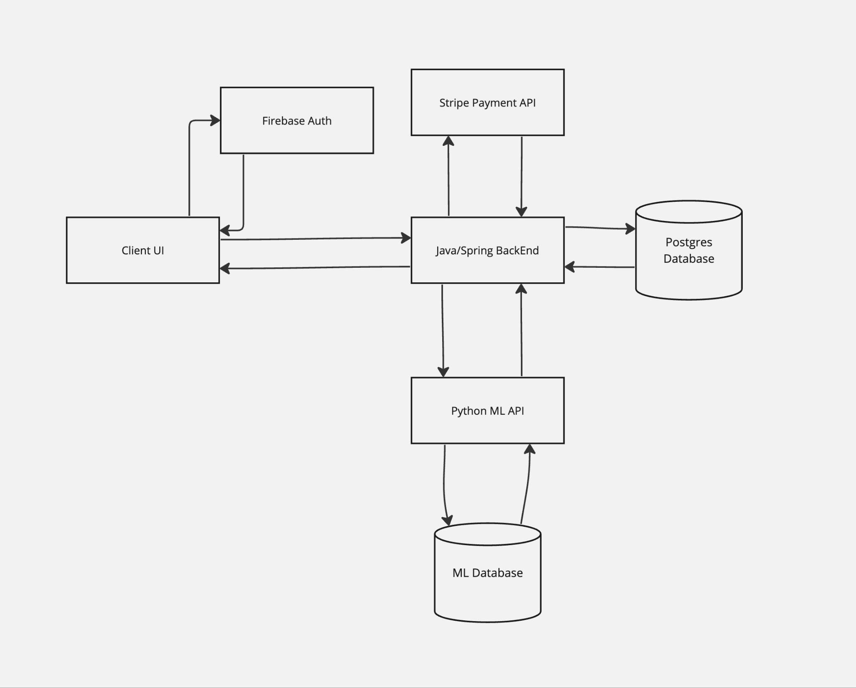
Conceptual Architecture Diagram

Slide 20
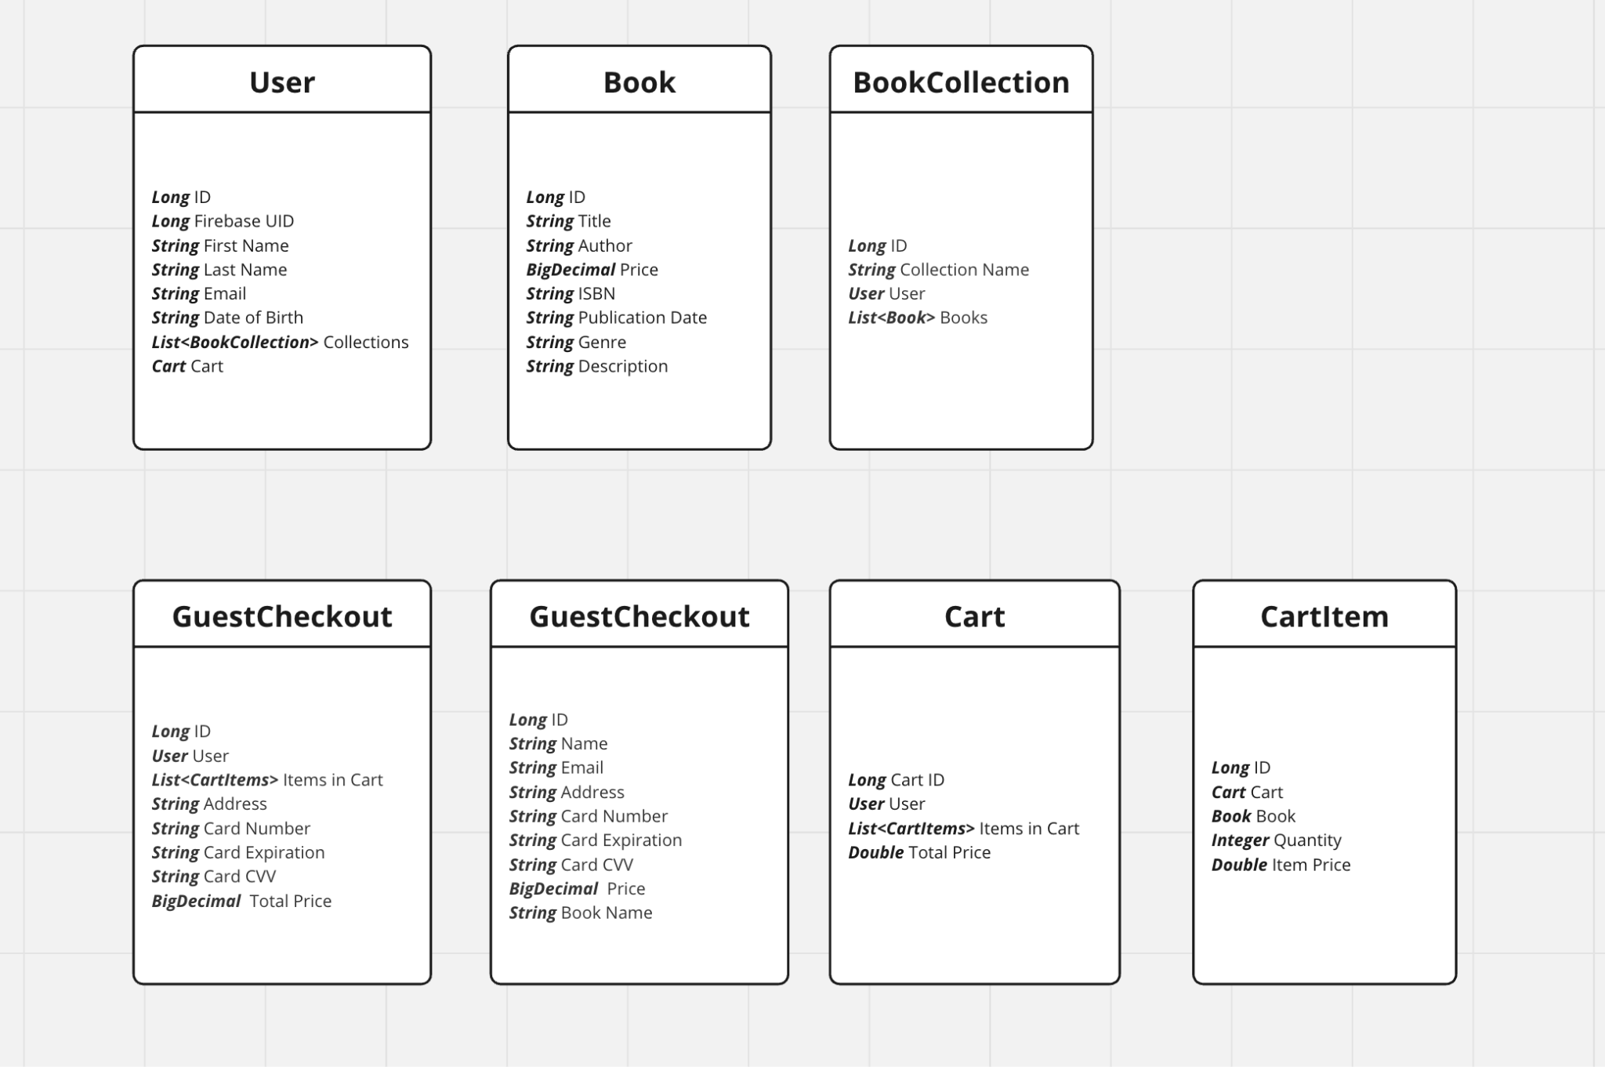
Class Diagram

Slide 21
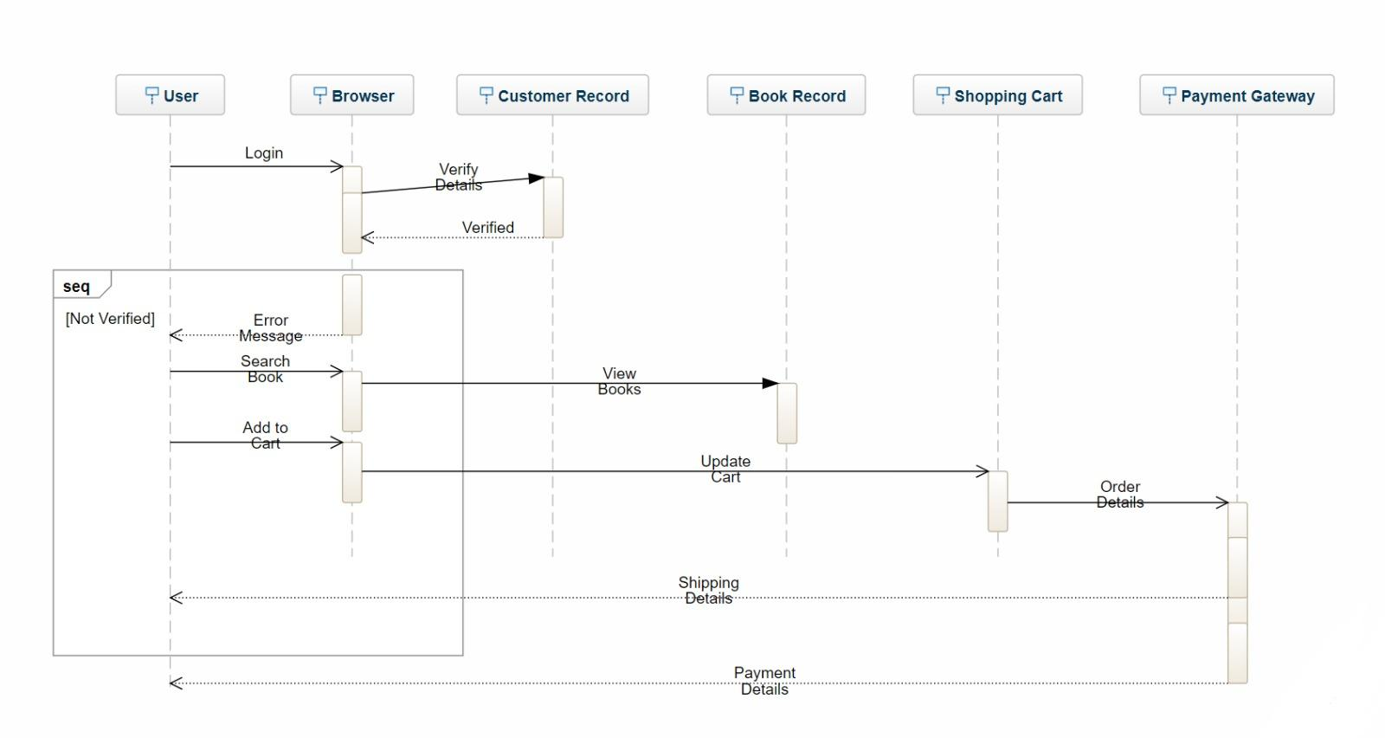
Sequence Diagram

Slide 22
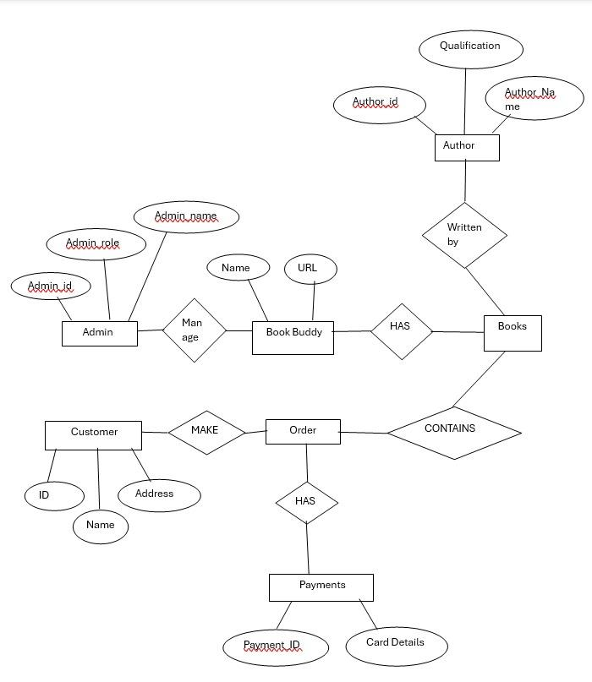
Entity Relationship Diagram

Slide 23
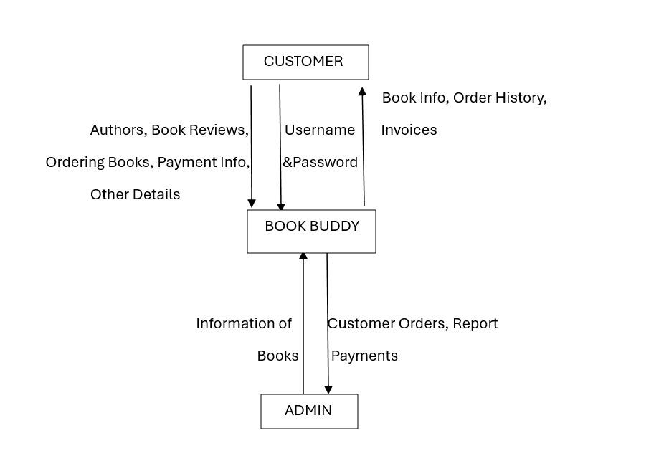
Context Diagram

Slide 24
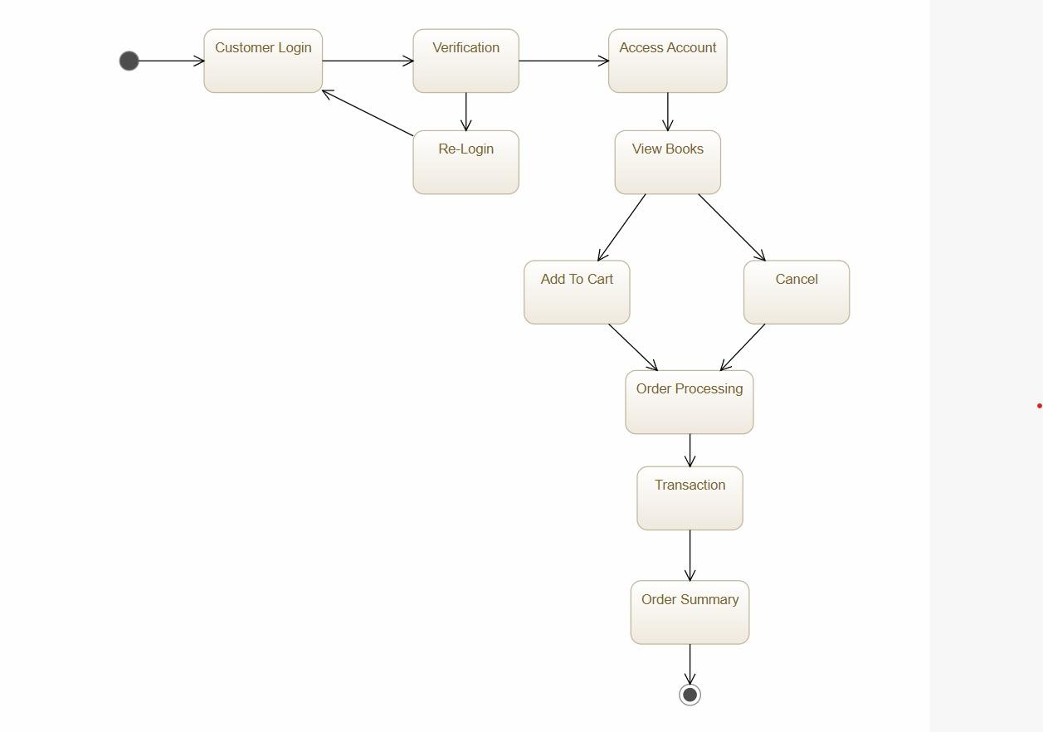
State Diagram

Slide 25
Sprint 3 Recap

Slide 26
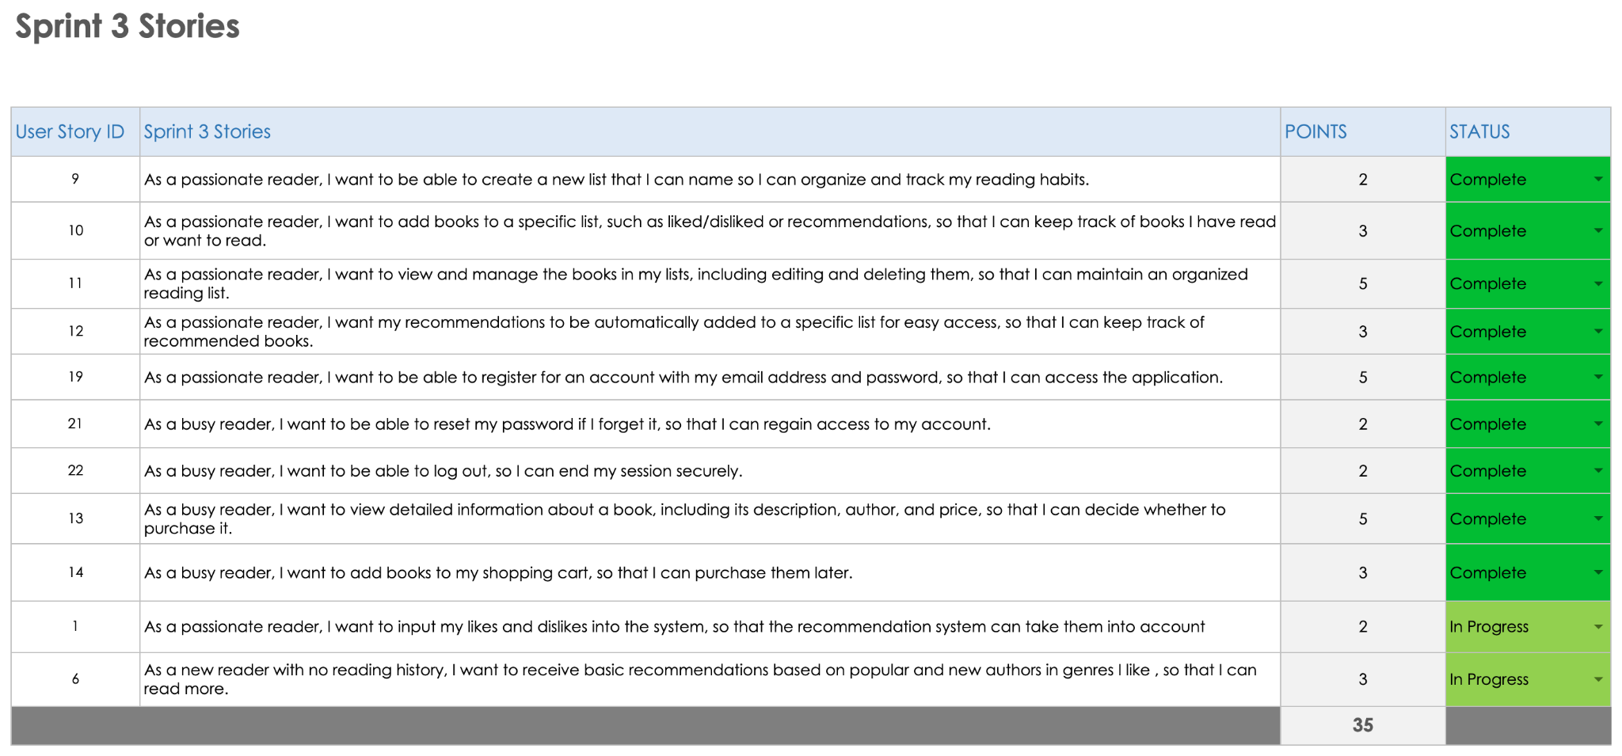

Slide 27
Product Backlog

Slide 28
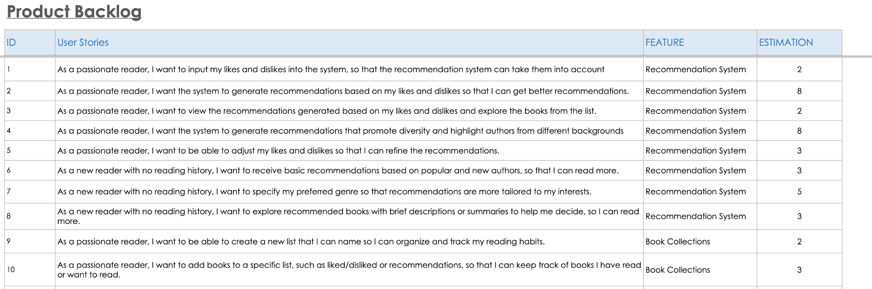

Slide 29
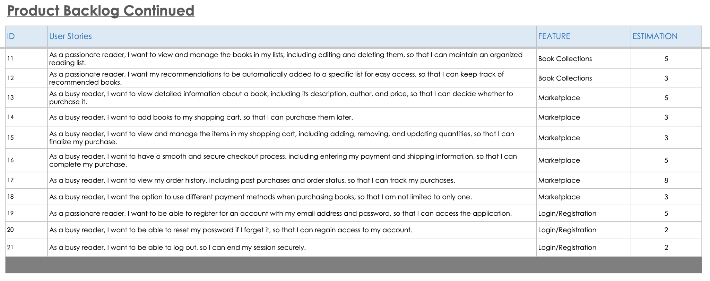

Slide 30
Sprint Summaries

Slide 31
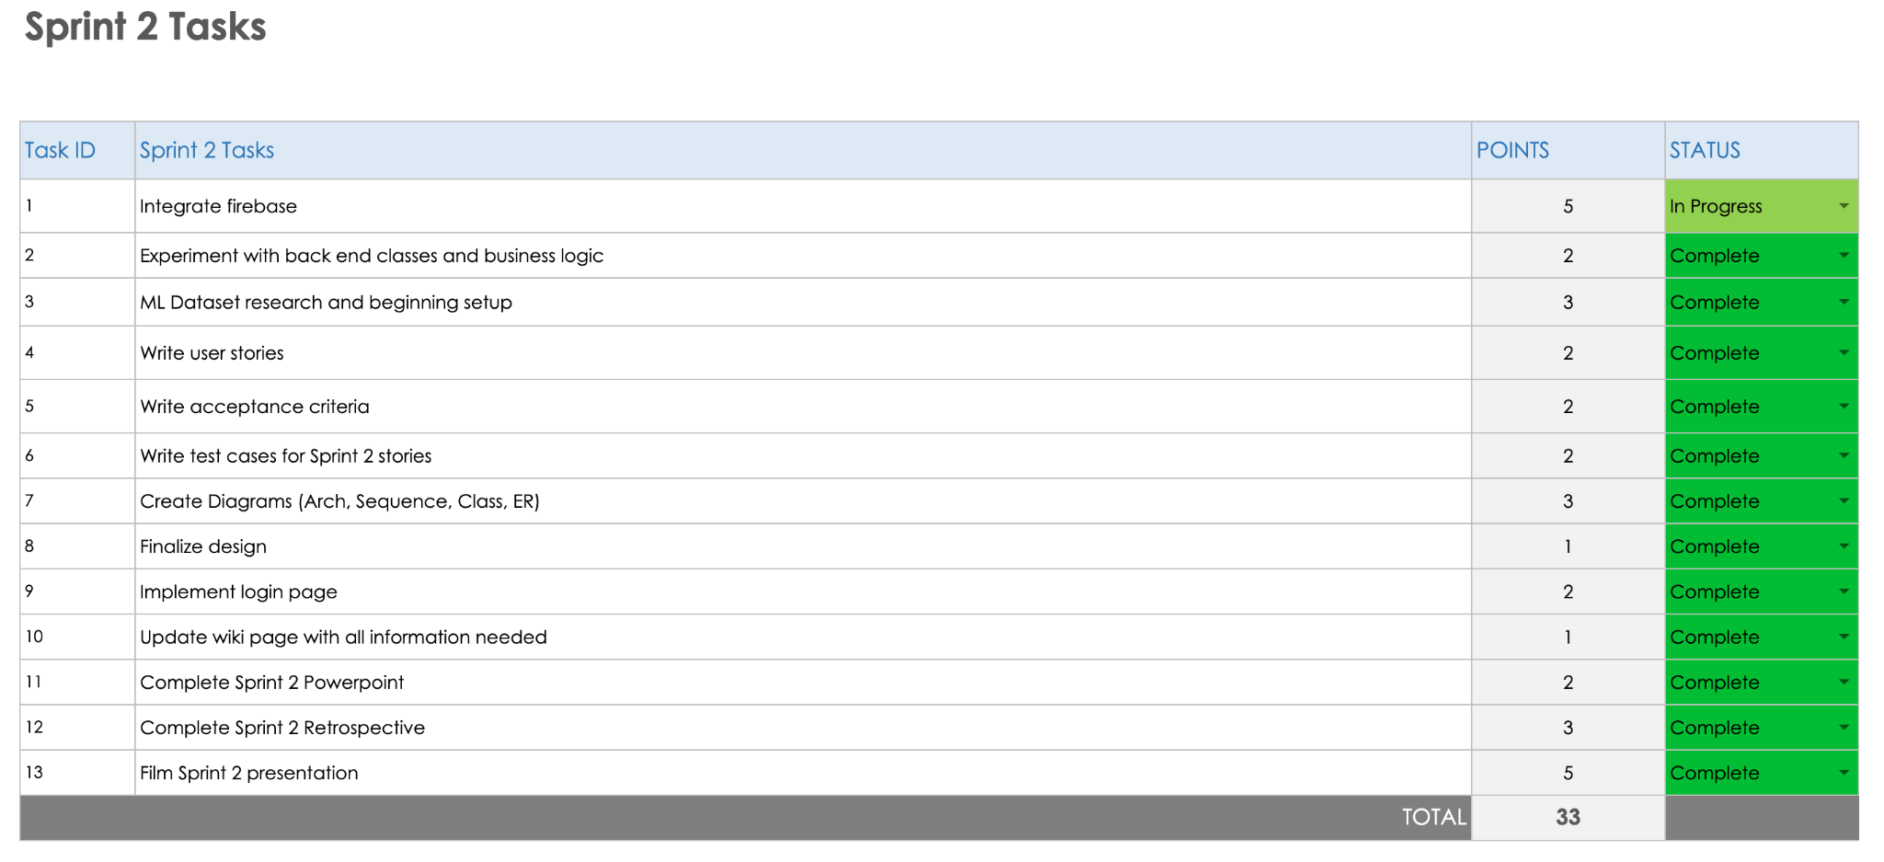
Sprint 2 Tasks

Slide 32
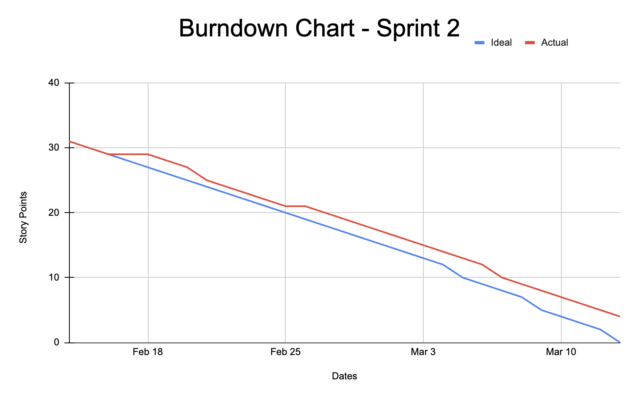

Slide 33
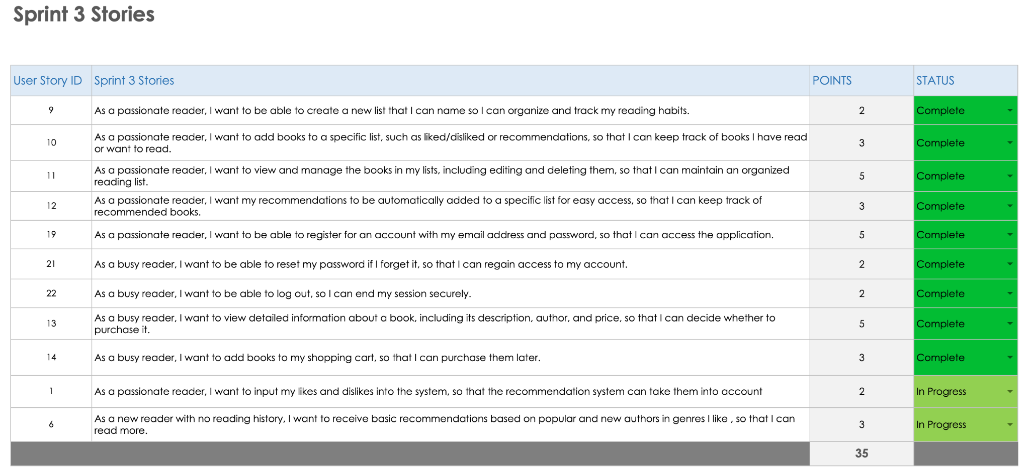
Sprint 3 Stories

Slide 34
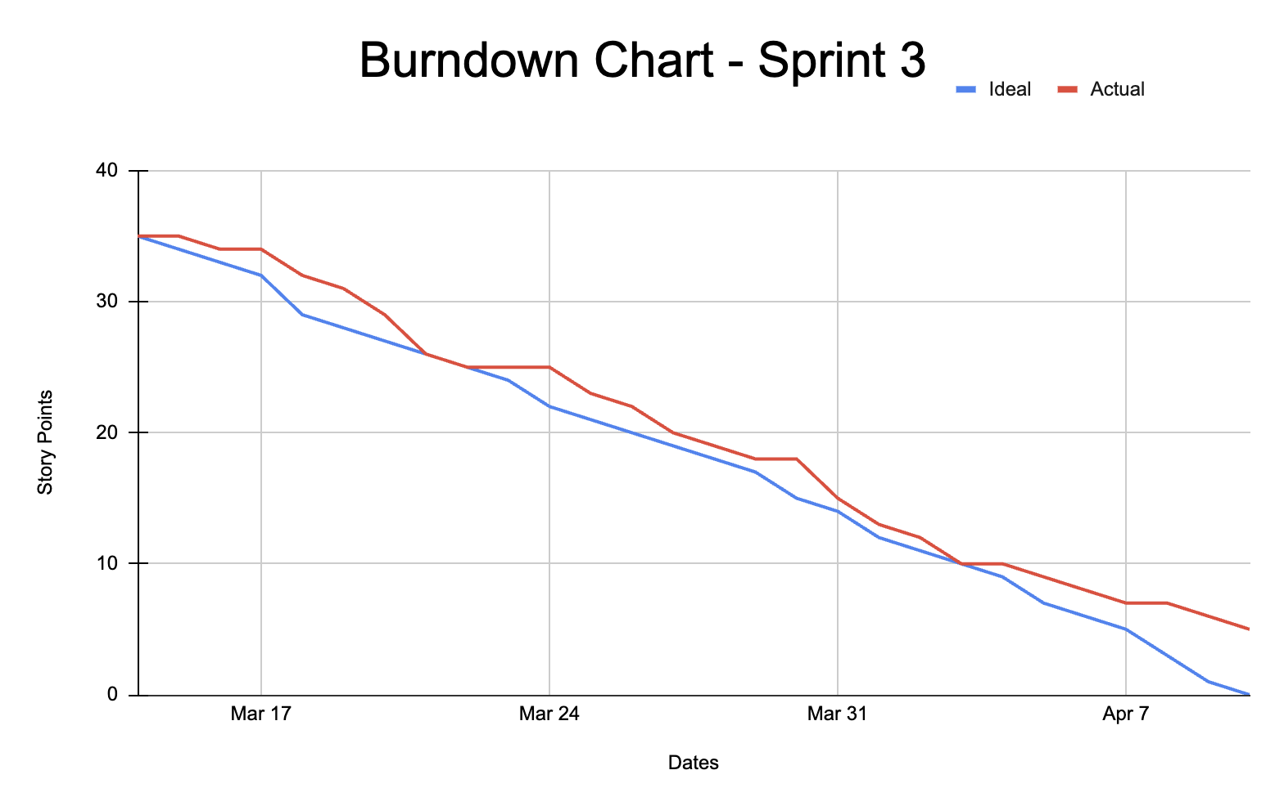

Slide 35
Sprint 4 Backlog

Slide 36
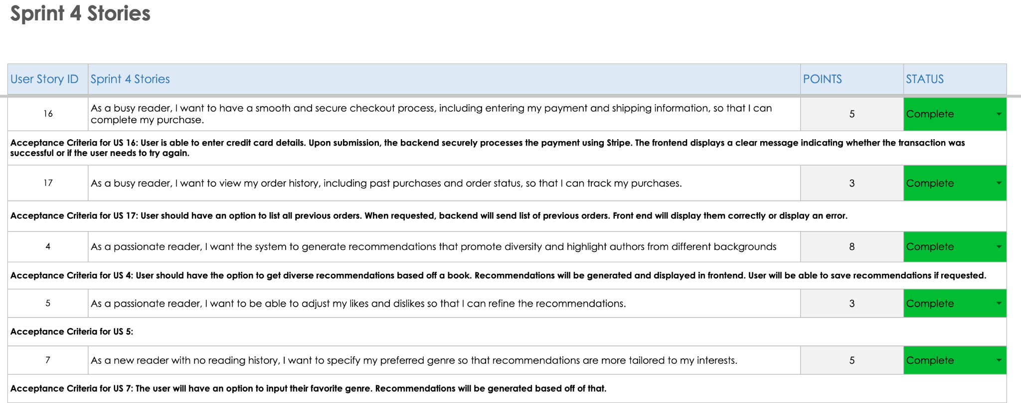

Slide 37
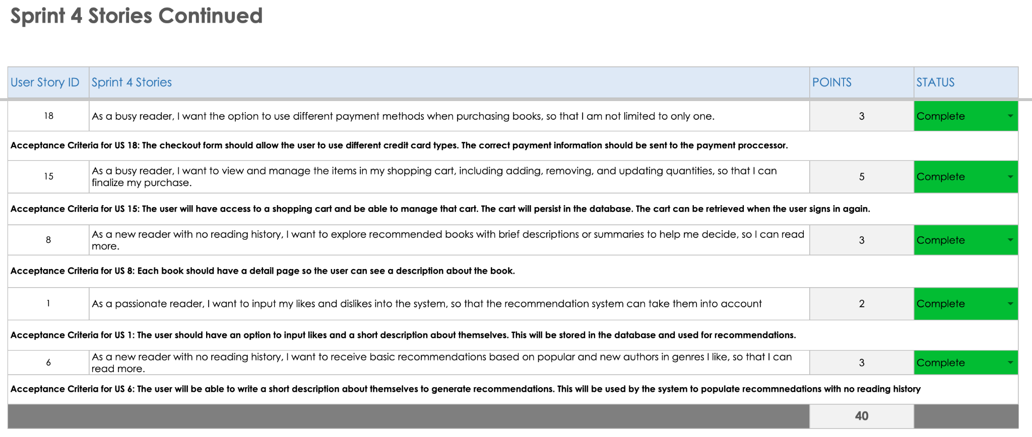

Slide 38
Sprint 4 Test Cases

Slide 39
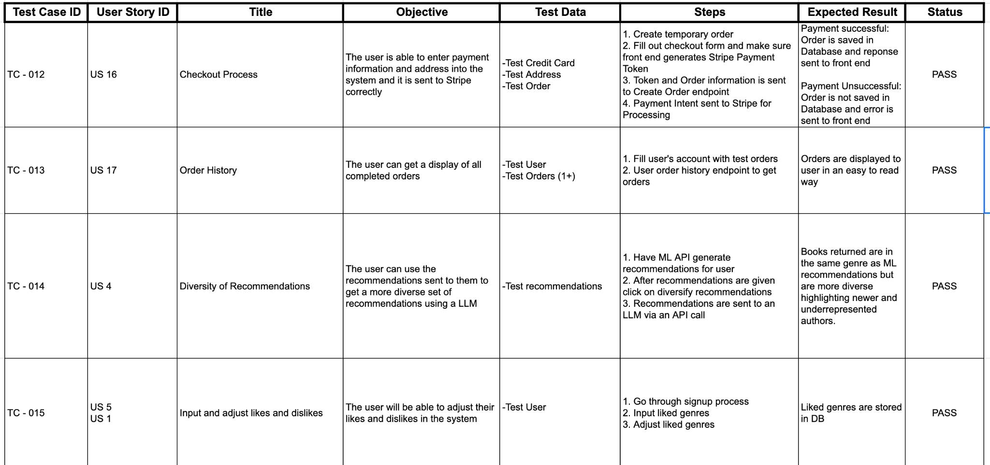

Slide 40
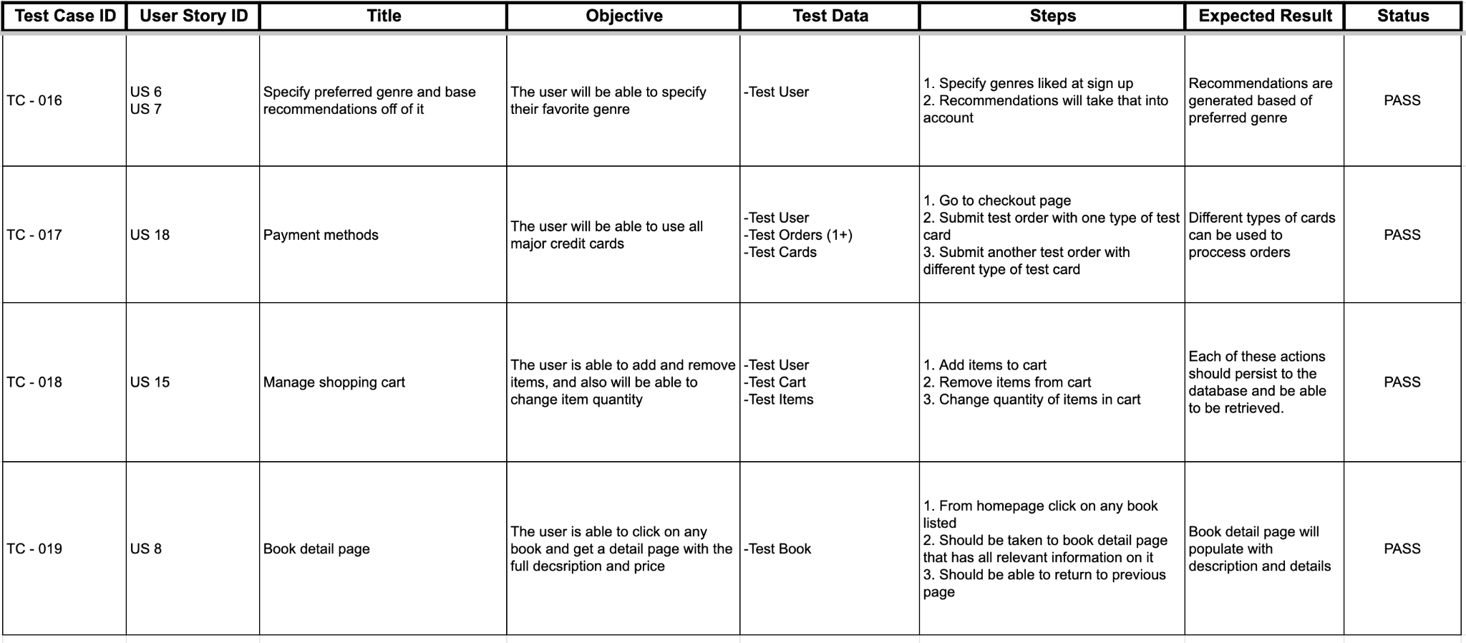

Slide 41
Sprint 4 Metrics and Charts

Slide 42
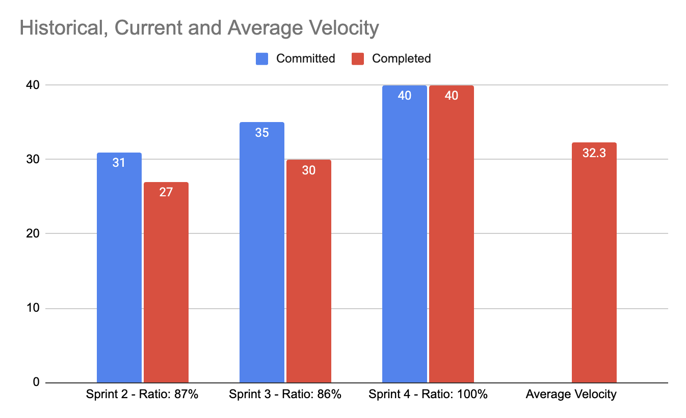
Velocity and Completed/Committed Metrics
Velocity:
-Sprint 2: 27 Points
-Sprint 3: 30 Points
-Sprint 4: 40 Points
Average Completed/Committed Ratio: 91%

Slide 43
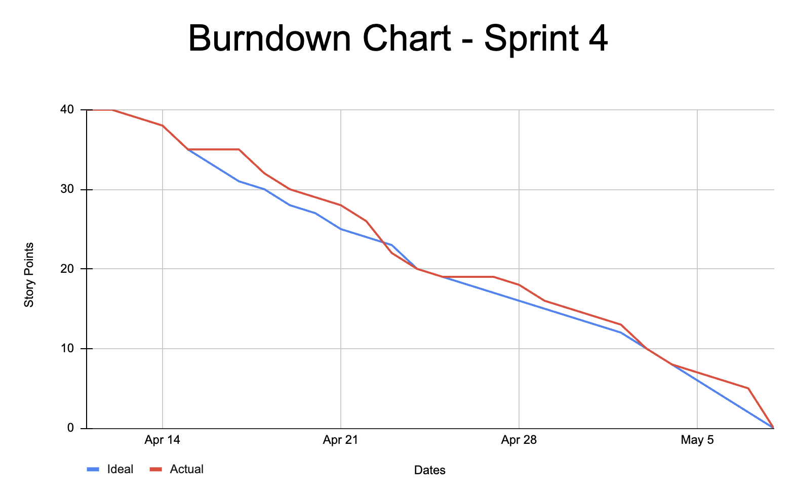

Slide 44
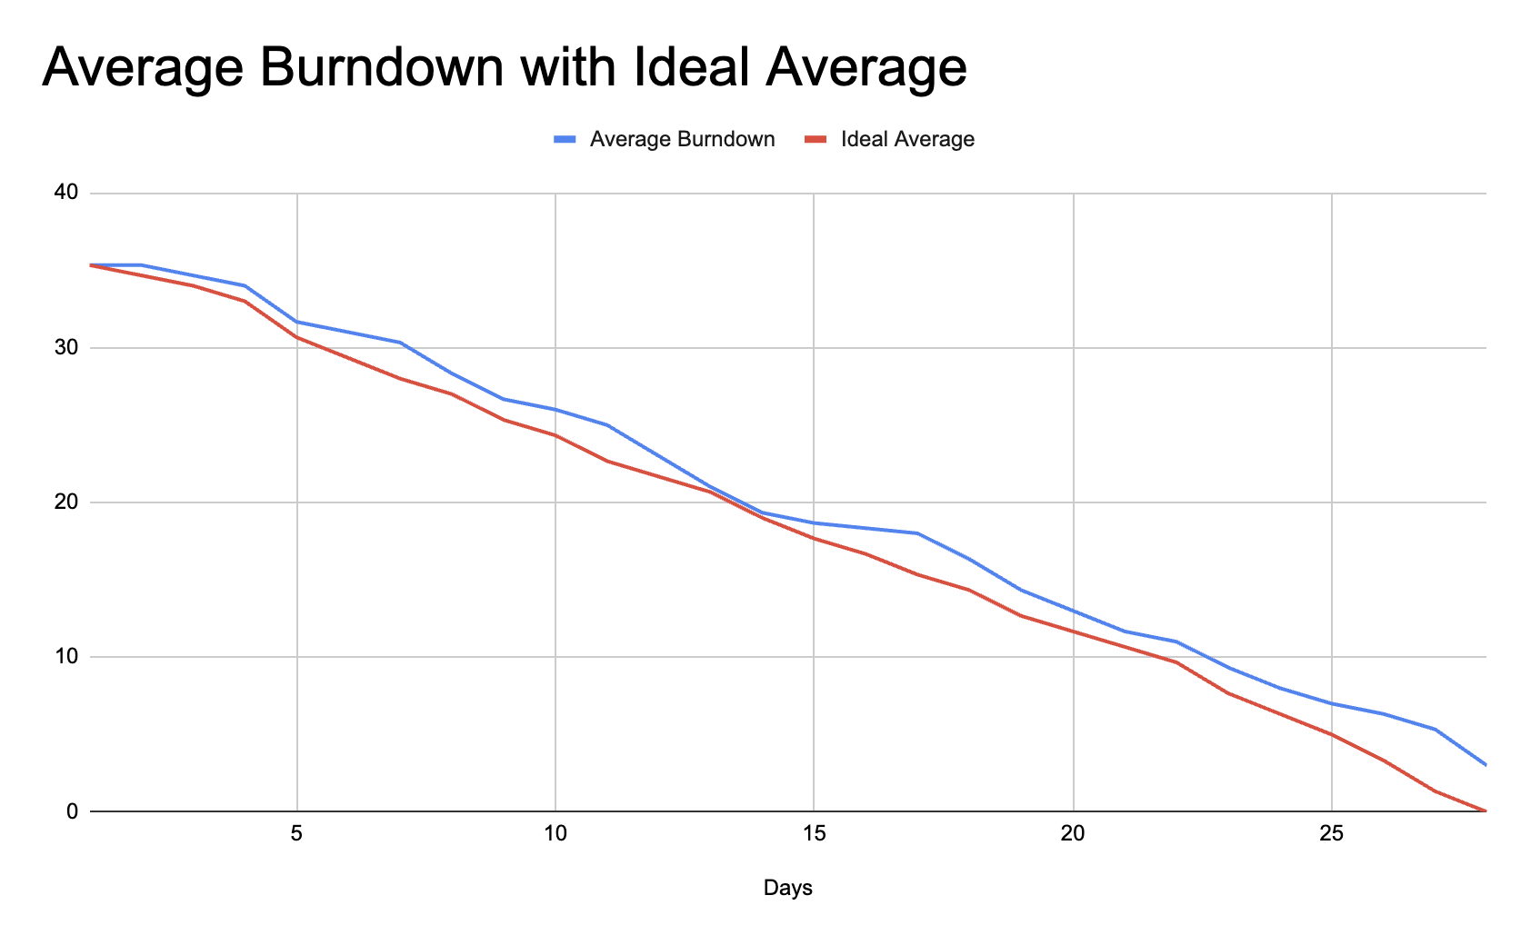

Slide 45
Sprint 4 Retrospective

Slide 46
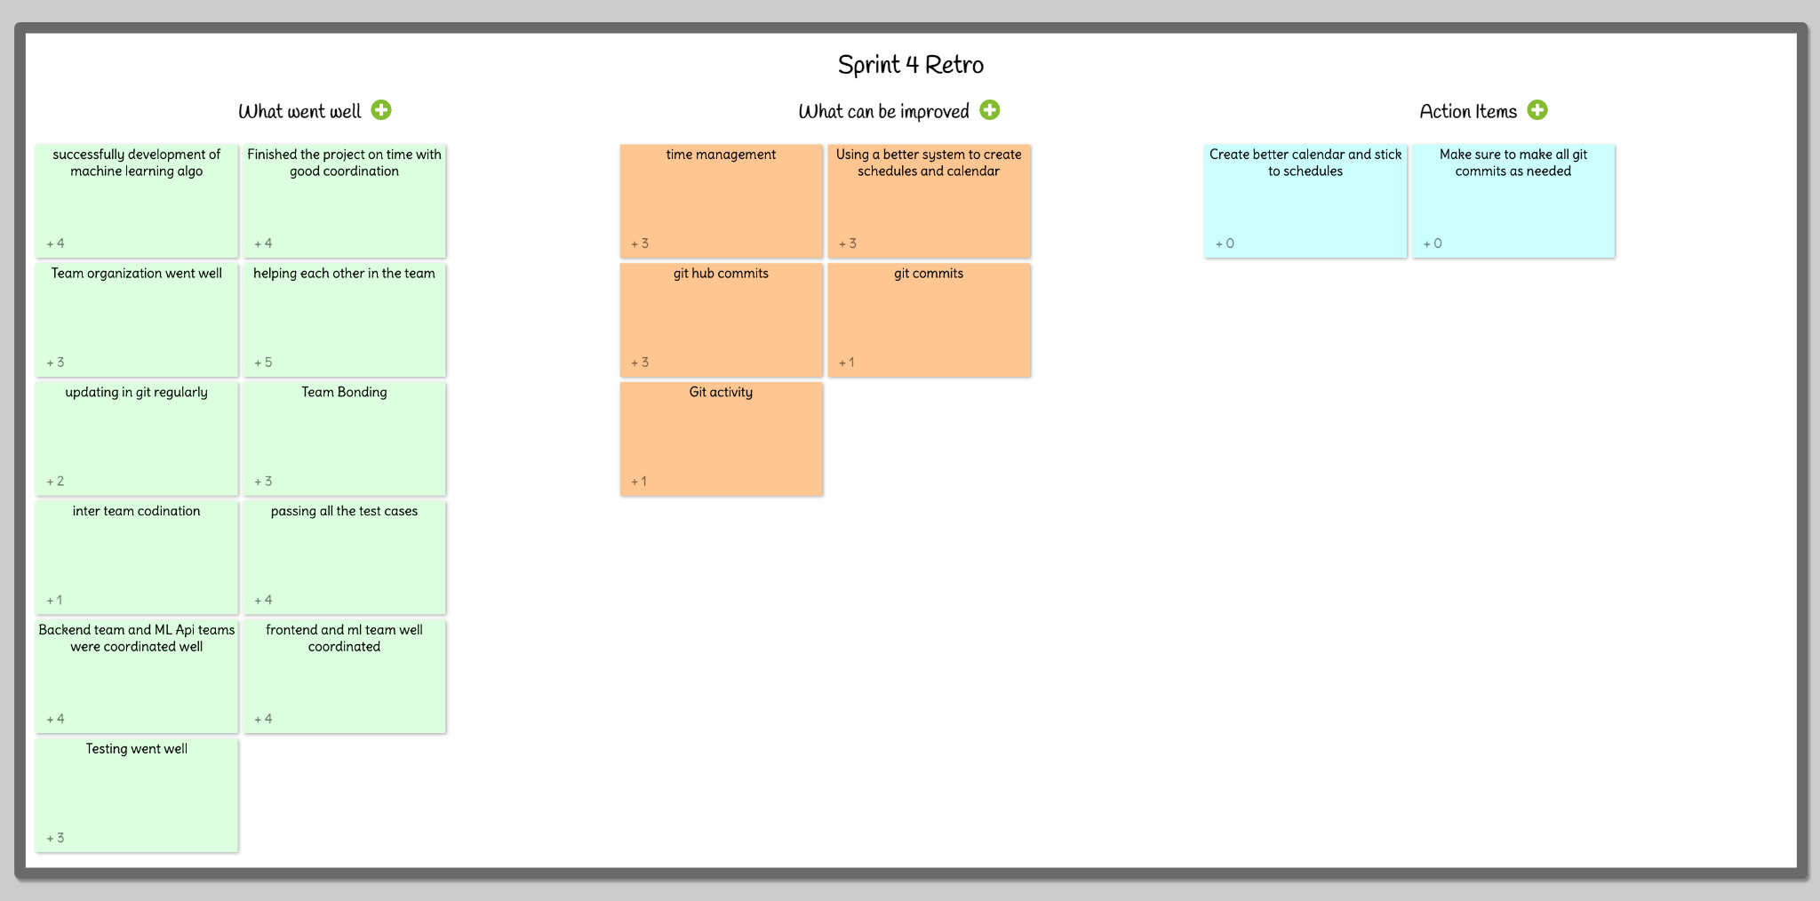

Slide 47
Demo for Sprint 4

Slide 48
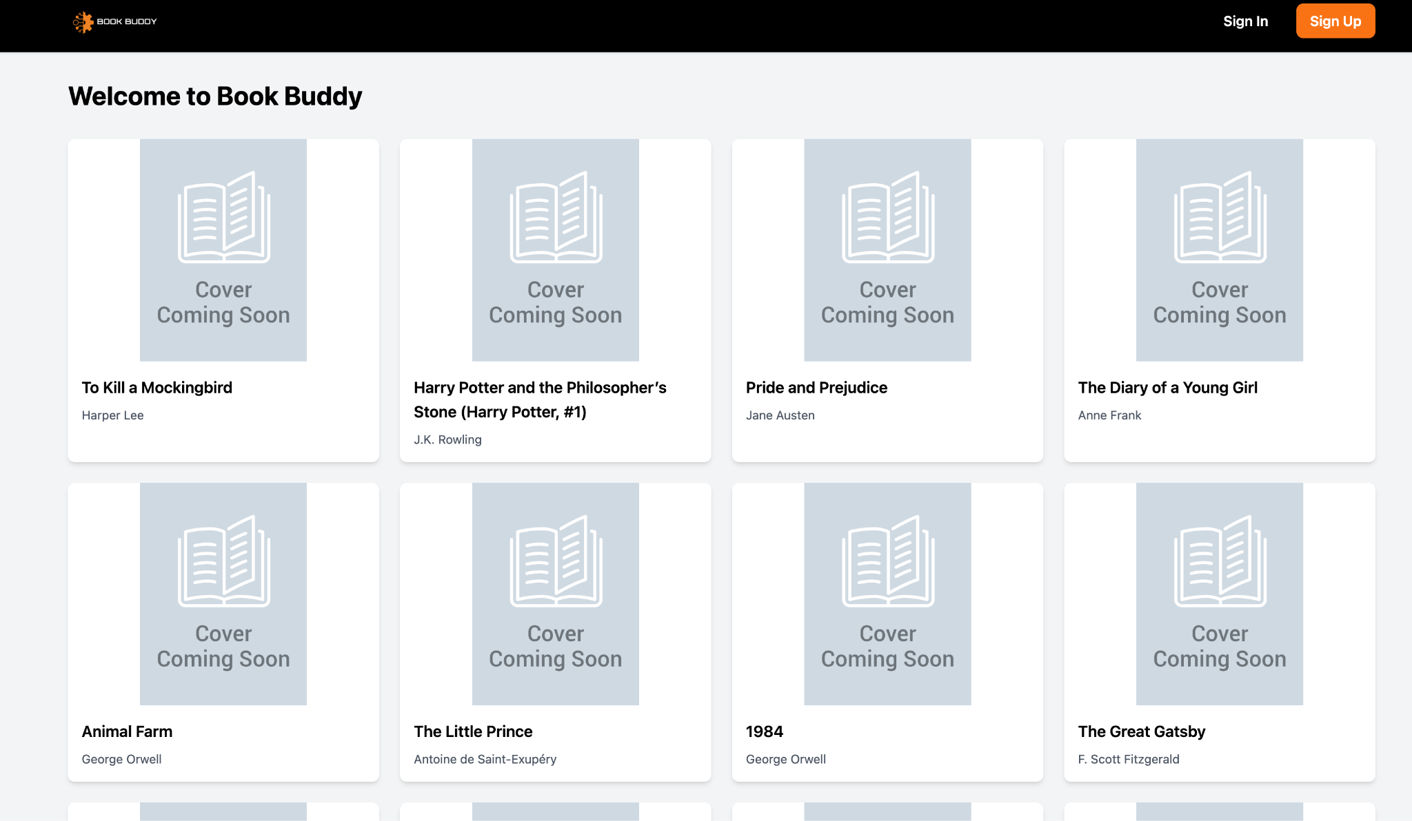
Demo Screenshots

Slide 49
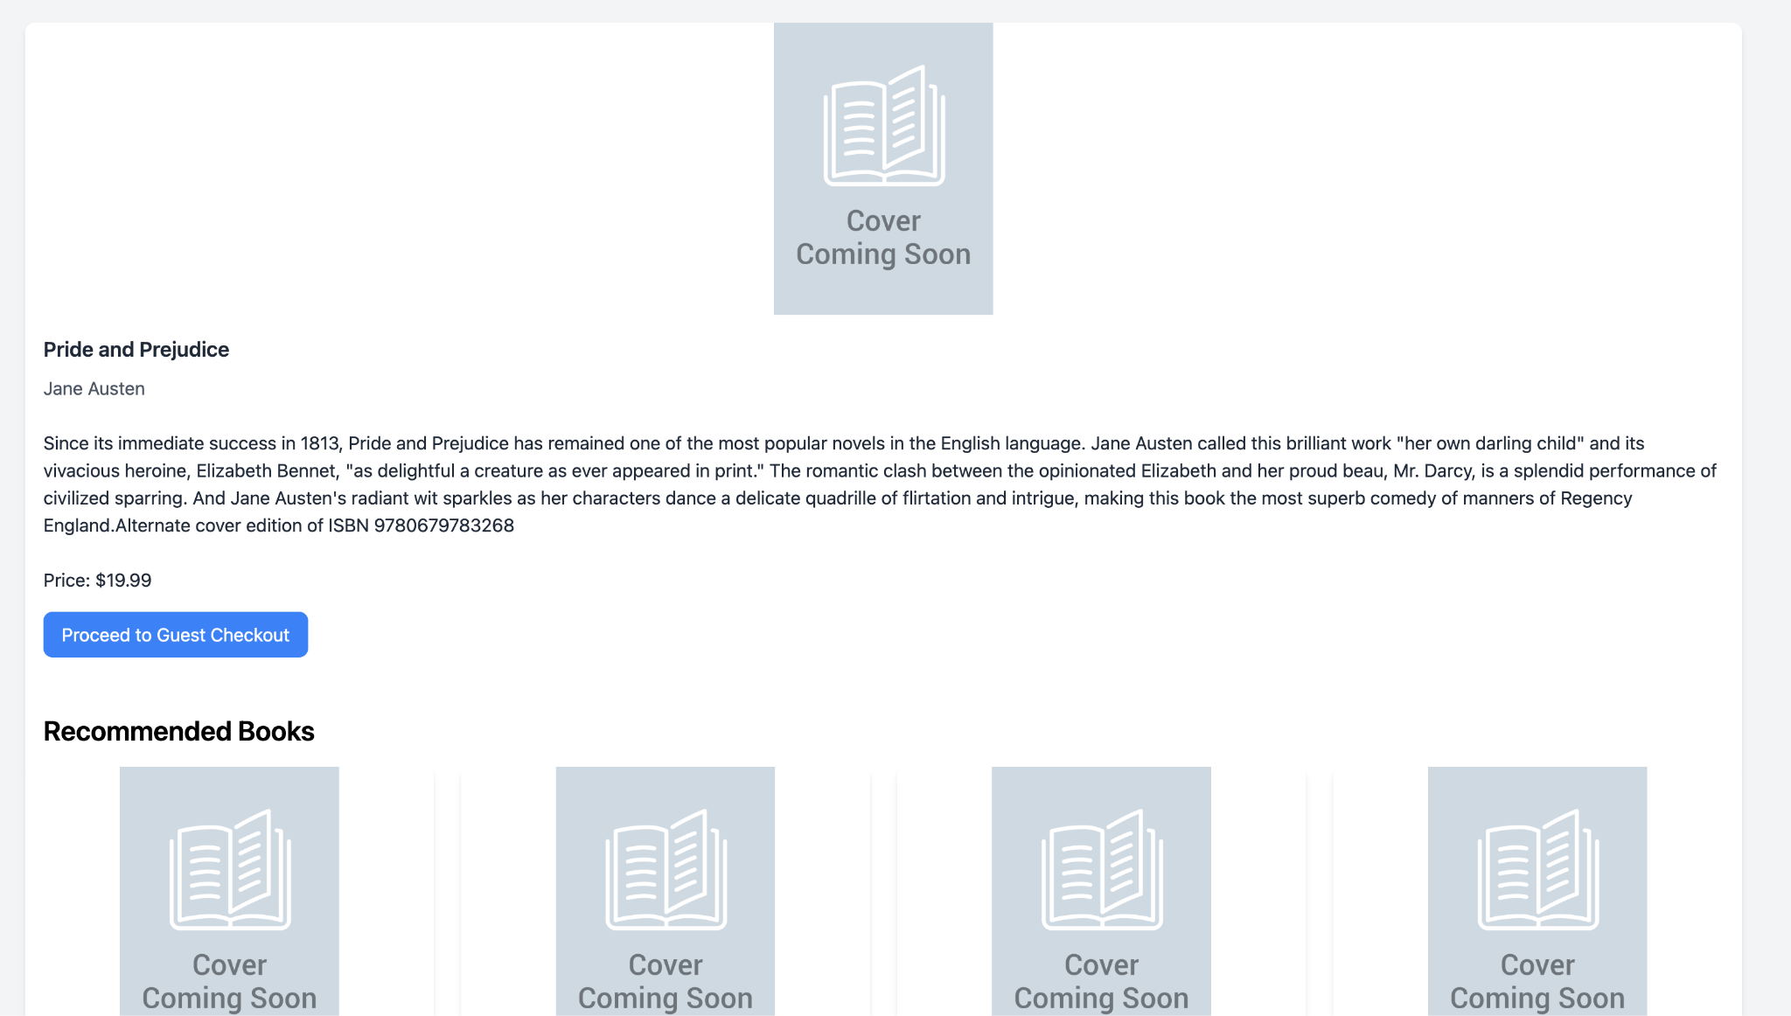

Slide 50
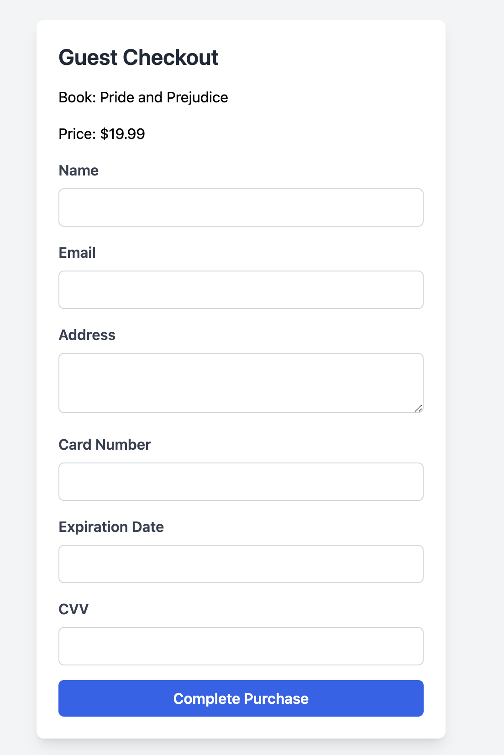
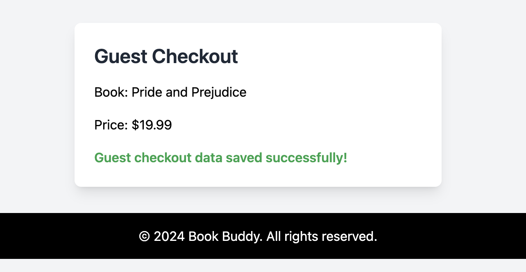

Slide 51
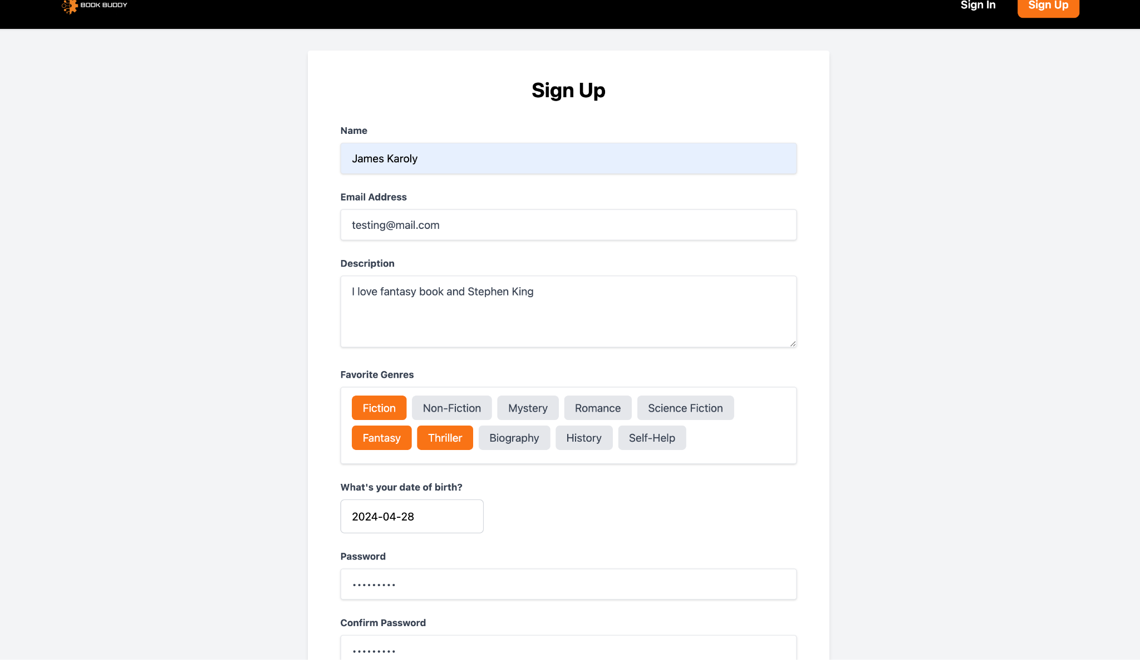

Slide 52
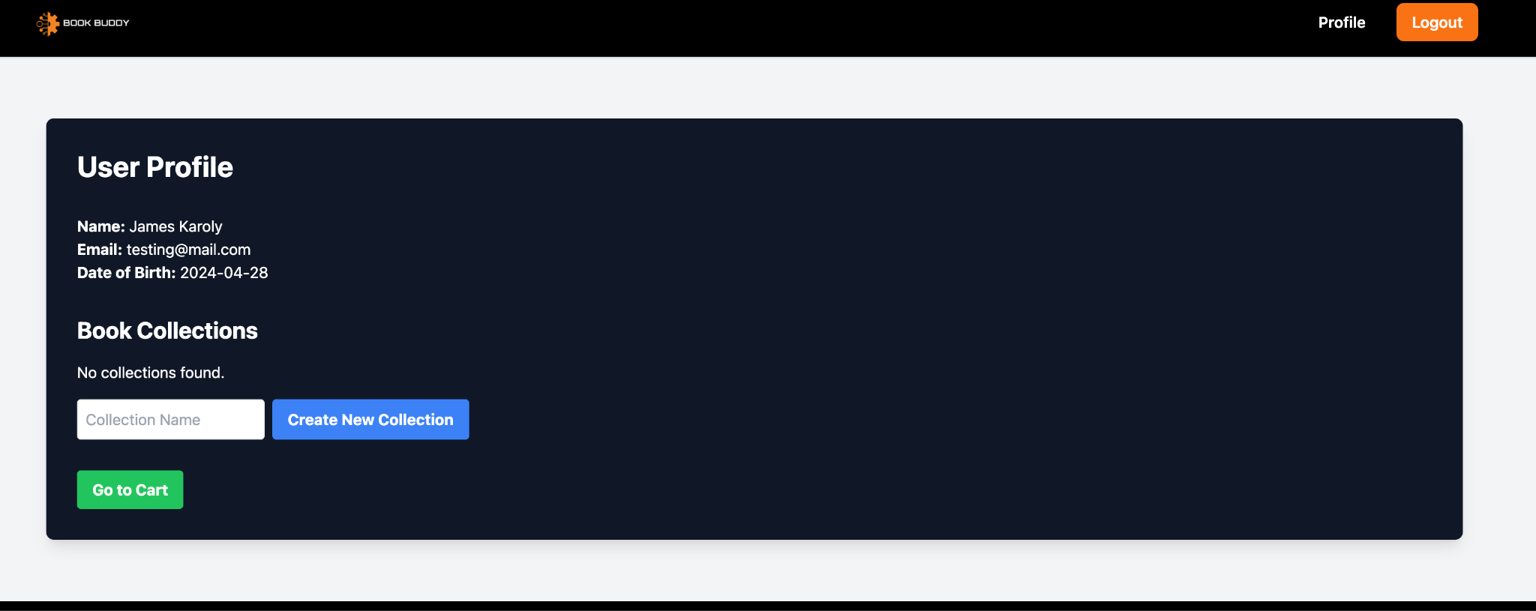

Slide 53
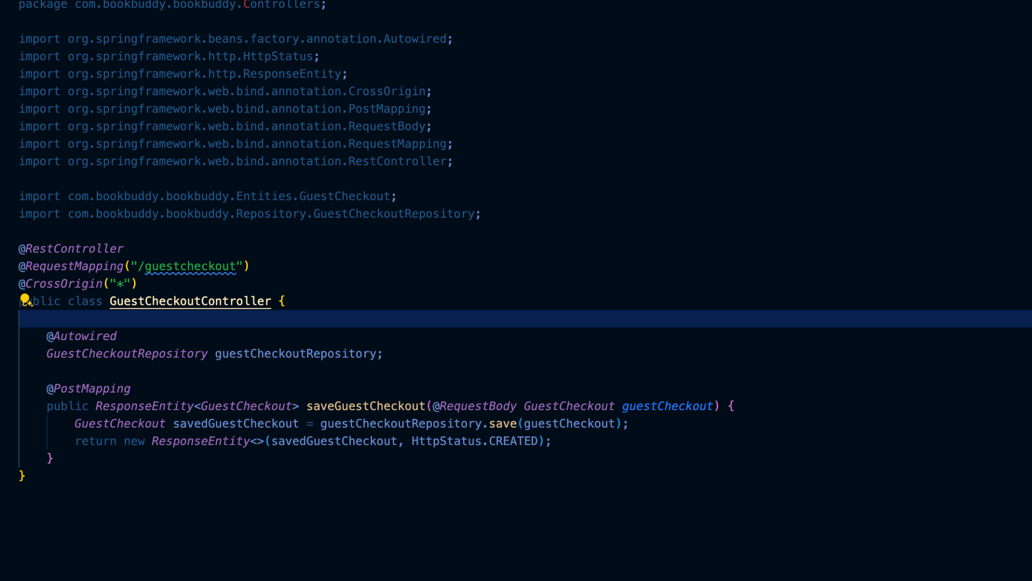
New Guest Checkout Route

Slide 54
WikiPage Link
https://github.com/htmw/2024S-Code-Avengers/wiki

Slide 55
Application Demo

